Slide 1
TODAY’S LECTURE OUTLINE
Sex and Gender: The same or different?
Gender role socialization
“Doing gender”
Gender as a social construct
Variations in gender
Cross-cultural; Historical
Gender gap in pay
Notes:
Today’s class is about gender, and just like with race, entire sociology courses are taught on this topic alone
--so consider what we discuss today the bare-bones basics!
We’ll start with making clear distinctions between sex and gender
--and we’ll discuss what gender roles are as we learn how gender is socially constructed
We’ll also talk about what “doing gender” means
--and what cultural and historical variations in men’s and women’s roles tell us about gender as a social construct
Finally we’ll end with a look at a contemporary debate on the gender gap in pay
--evidence that gender, while a social construction
---is also a social reality with genuine consequences
Next Monday, we’ll broaden our understanding of distinctions of social difference by looking at sex and sexuality

Slide 2
To the extent that there are differences between men and women when it comes to how they express their feelings, would you say these differences are …
Mostly based on biological differences between men and women
Mostly based on different expectations society has for men and women
Notes:
I want us to start with a survey question that will help us to think about some of the topics we’ll be discussing today. In 2017, the Pew Research Center conducted a nationally representative survey of U.S. adults asking them questions about their views on gender. This was one of the questions.
Take out your clickers and tell me what you think.
[Open poll; display results after finished.]

Slide 3
http://www.pewresearch.org/fact-tank/2017/12/05/how-do-your-views-on-gender-compare-with-those-of-other-americans/?utm_content=buffer915d1&utm_medium=social&utm_source=twitter.com&utm_campaign=buffer
Notes:
Here’s what Pew found.
[Discuss comparison to class results as needed. Solicit student comments as needed.]

Slide 4
http://www.pewresearch.org/fact-tank/2017/12/05/how-do-your-views-on-gender-compare-with-those-of-other-americans/?utm_content=buffer915d1&utm_medium=social&utm_source=twitter.com&utm_campaign=buffer
Notes:
Here’s nationally representative results broken down by gender.
[Discuss comparison to class results as needed. Solicit student comments as needed.]
(click) And here they’re broken down by political party.
[Discuss comparison to class results as needed. Solicit student comments as needed.]
What do sociologists say about the relationship between biology and society in regards to gender? Let’s start by thinking about the concepts of sex and gender.

Slide 5
SEX AND GENDER: THE SAME OR DIFFERENT?
Notes:
OK, we use the terms sex and gender all the time
--often interchangeably, but are they the same?
As your Lorber reading states, views on sex and gender are so pervasive in our society
--we assume it is bred into our genes
And because of those views, some think there is little difference between the two
(click) Let’s take this popular book by pop psychologist, John Gray.
--“Men are from Mars, women are from Venus.”
This 1992 relationship guidebook has sold over 14 million copies and inspired a dozen spin-offs.
(click) Have any of you heard of it? What does it say?
--men and women are so different, it is like we are from different planets
What might that have to do with our understandings of sex and gender?
--in essence (click) it argues that men and women are different biological organisms
---and that the inherent biological differences between men and women
----manifest themselves in the ways men and women behave, act, do
By nature, men don’t like to express their feelings
--and women, by nature, do…we are more expressive and communicative
---these things are just biological givens
----so the book would suggest that individuals must take personal action to navigate what nature has given us
(click) this thinking leads to a conflating of sex and gender
--in essence a conflating of the biological and the social!
While this thinking has an intuitive appeal, (click) sociologists would argue that sex does not equal gender
--yes, sex is biologically based
---but like race, we see gender as socially constructed
---a way we have created to structure social relations and define divisions of power and privilege
Let’s dig into this a bit more!

Slide 6
DEFINING SEX AND GENDER
SEX: (socially agreed-upon) biological differences that distinguish males from females (e.g., penis and vagina)
GENDER: set of social arrangements and expectations that are built around normative sex categories (e.g., views on what is “masculine” and “feminine”)
Sex ≠ Gender
All sociologists agree that gender is socially constructed, but gender scholars usually add that so is sex.
Notes:
Sex typically refers to the biological differences that distinguish males from females
--your gender spectrum reading says “the physical structure of one’s reproductive organs”
---penis, breasts, vagina, testicles, uterus – yes I said them ☺
----also hormonal differences in amounts of estrogen and testosterone in our bodies and our chromosomal differences
(click) Gender, by contrast, is a social construct
--it refers to a set of social arrangements and expectations that are built around normative sex categories
---in basic terms, our conceptions of masculinity and femininity; what a man and woman should be, do, act
In other words, if sex refers to our physical organs and other biological components
--gender is what we as a social group do and expect from individuals of particular sexes
(click) so, to a sociologist, sex does not equal gender
--Gender is a social construct, a created social position
---a purposefully crafted indicator of social difference

Slide 7

Why is sex also socially determined? –Thomas Laqueur
Ideology determines the evidence we see from anatomy.
One-sex versus two-sex models.

Slide 8
THE SOCIAL CONSTRUCTION OF GENDER
Gender Roles
Sets of behavioral norms assumed to accompany one’s status as male or female
E.g., men: strong; women: sensitive
Gender Role Socialization
Learning of male- and female-typed roles and practices via agents of socialization (e.g. family, schooling and the media)
Notes:
Our conceptions of gender – that of masculinity and femininity, boy things and girl things -- are social inventions
--that change as political, economic, and historical contexts change
But how does this happen?
--right, (click) socialization!
Sociologists argue, we start learning our gender roles very early on.
--(click) these are sets of behavioral norms we assume are accompanied by one’s biological sex
---for example men are strong; women caring; men aggressive; women docile
-----Who has others? Great!
Now our socialization into gender roles start as soon as we leave the womb
--(click) Gender role socialization is the learning of male- and female-typed roles and practices via those agents of socialization that we talked about earlier in the semester – our family, schools, peers and the media.
From birth we are dressed either in pink or blue right away to designate our sex.
--There are signs, balloons, greeting cards announcing “It is a boy!” or “It’s a girl!”
This seemingly benign action creates a context for older kids and adults to treat baby boys and girls differenlty
Consider the following two scenes
--these are actual dialogues recorded in a maternity ward.
Two newborns a few hours old lie in the nursery of a hospital maternity ward.
--One is a male, wrapped in a blue blanket; the other is a female in a pink blanket

Slide 9
Grandma A: There he is—our first grandchild, and a boy
Grandpa A: Hey, isn’t he a hefty little fellow? Look at that fist he’s making. He’s going to be a regular little fighter, that guy is. At-a-boy.
Grandma A: I think he looks like you. He has your strong chin. Oh, look, he’s starting to cry.
Grandpa A: Yeah—just listen to that set of lungs. He’s going to be some boy.
Grandma A: Poor thing—he’s still crying.
Grandpa A: It’s okay. It’s good for him. He’s exercising and it will develop his lungs.
Grandma A: Let’s go and congratulate the parents. I know they’re thrilled about little Fred. They wanted a boy first.
Grandpa A: Yeah, and they were sure it would be a boy too, with all that kicking and thumping going on even before he got here.
Source: Walum, 1977 in Giddens et al., 2000
Notes:
(read slide)
So putting on your sociologist hat – what are some cues here about gender role assumptions?
--the set of behavioral norms assumed to accompany the act of being born with a penis
Right; strong; preference for boys, active, big, fighter, independent
Let’s do the baby girl dialogue now

Slide 10
Grandma B: There she is…the only one with a pink bow taped to her head. Isn’t she darling?
Grandpa B: Yeah—isn’t she little. Look at how tiny her fingers are. Oh, look—she is trying to make a fist.
Grandma B: Isn’t she sweet…you know, I think she looks like me.
Grandpa B: Yeah, she sorta does. She has your chin.
Grandma B: Oh, look, she is starting to cry.
Grandpa B: Maybe we better call the nurse to pick her up or change her or something.
Grandma B: Yes, let’s. Poor little girl.
Grandpa B: Let’s find the nurse. I don’t like to see her cry.
Grandma B: Hmm. I wonder when they will have their next one. I know Fred would like a son, but little Fredricka is well and healthy. After all, that’s what really matters.
Grandpa B: They’re young yet. They have time for more kids. I’m thankful too that she’s healthy.
Grandma B: I don’t think they were surprised when it was a girl anyway…she was carrying so low.
Source: Walum, 1977 in Giddens et al., 2000
Notes:
(read slide)
--Ok so what are the gender role assumptions here?
---Right; pretty, petite, needs to be protected/cared for; not active; girls are not preferred
The two real conversations are quite different
--An infant is born, marked as a male or a female, and then everyone who interacts with the child treats it in accordance with what its expected of its gender role
Additional studies have found that people interact with babies differently based on their knowledge of the baby’s sex
--baby boys are told they are big and strong and held outward to see the world
---while baby girls are told they are pretty, and snuggled inward so as to protect them
The larger social world interacts with boy and girls differently
--and consequently socializes them in to different roles

Slide 11
On Your Own
Identify how gender is being socially constructed
Notes:
We’re going to watch a short video clip of an experiment where boy babies are dressed up like girls and vice versa.
While we watch, I want you to (click) on your own make notes about how gender is being socially constructed.
After the video, you’ll discuss this with your neighbors

Slide 12
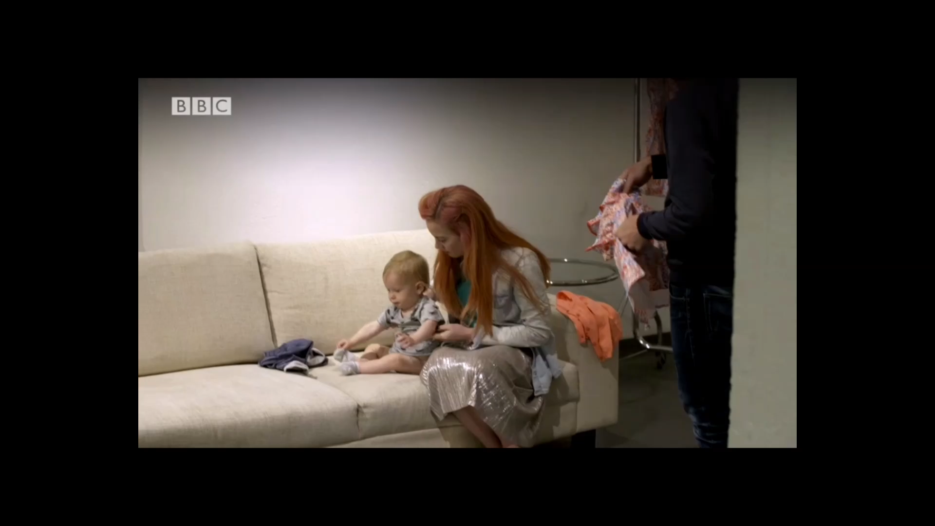
Notes:
--
1:41
BBC News
Original video 3:25, edited down to 1:41
Published 8/16/2017
Downloaded: 3/4/2019
https://www.bbc.com/news/av/magazine-40936719/gender-specific-toys-do-you-stereotype-children

Slide 13
Explain the clip in terms of
gender roles
and
gender socialization
Notes:
Now I want you to discuss the clip with a partner.
We just talked about the concepts of gender roles and gender socialization. So talk with a partner about using these concepts to explain the video.
You have 2 minutes to discuss. (click)
---
[AFTER TIME IS UP: ask for people to share to the full class for each of the questions; discuss as needed]

Slide 14
SEX GENDER
Sex is biological
Gender is…
fluid
historically and culturally specific
socially constructed
and has consequences across place and context
Notes:
So to recap,
--Sex is not the same as gender
Sex is biological; gender is (click, read slide)
Let’s talk through some example that illuminate each of these points about gender

Slide 15
TWO GENDERS?
Three genders in Navajo society
masculine men
feminine women
the nadle (mixed gender)
We’wha (1849-1896)
A ‘two-spirit’ from the Zuni tribe
Source: Will Roscoe, The Zuni Man-Woman, UNM Press, 1992
Notes:
If gender was just a matter of biology,
--we wouldn’t have such different manifestations of gender throughout history and across cultures
In many Western cultures, we see a neat division of the world into men and women.
--by equating sex with gender, we operate in a binary world
---the gender spectrum reading pushes us to think past this constructed binary
(click) This is not the case for the Navajo society of Native Americans and some other cultures
--In Navajo tribes, there are not two but three genders:
---masculine men; feminine women
----and (click) the nadle (pronounced ’nadleeh’)
The nadle might be born with ambiguous genitalia at birth
--or they might declare a nadle identity later on in life regardless of physical body parts.
The nadle perform both masculine and feminine tasks and dress for the moment according to whatever activity they are doing.
--And they have freedom to marry any gender without any loss of status.
The picture here shows We’wha – who is one of the most well-known mixed-gender individuals in history
--he is from the Zuni tribe – not the Navajo. The Zuni referred to mixed-gender individuals as “two-spirits”.
[Source: https://en.wikipedia.org/wiki/We'wha]

Slide 16
WHAT MAKES AN ATTRACTIVE WOMAN?
A vintage ad, Huffington Post 1936
A Gap tweet from 2014
Source: http://www.huffingtonpost.com/2014/04/29/beauty-industry-women_n_5127078.html
Notes:
The binary nature of gender in the Western world is just one way gender is socially created
--as the Native American and National Geographic examples demonstrate
---gender is historically and culturally specific
(click) And even within the Western two-gender system
--there is enormous historical variation in what is considered as a ‘good’ man or a woman
---what signals masculinity and femininity
For example, how the ideal man or woman looks is itself historically contingent and socially constructed.
--(click) Take this vintage 1936 ad – for ironized yeast
---(read ad) 1000 of skinny girls gain 10-20 pounds quick!
The beauty ideal then was a voluptuous woman
--compare this to (click) this 2014 Gap ad
---the advertised ideal of beauty now is a much leaner, daintier look.

Slide 17
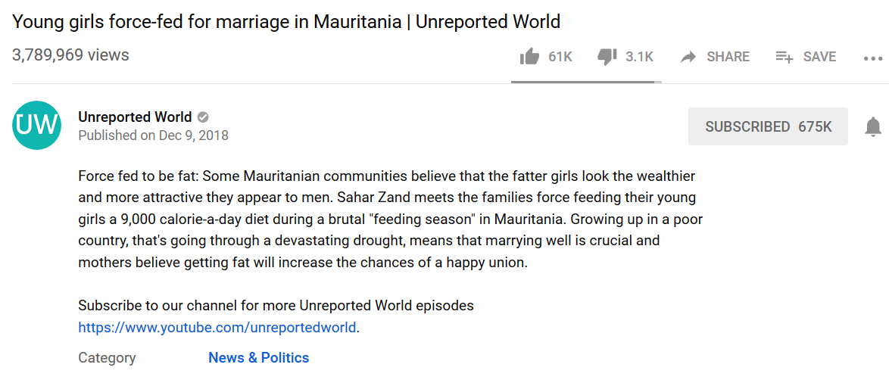
WHAT MAKES AN ATTRACTIVE WOMAN?

Slide 18
Today masculinity is associated with physical strength, sports, and money-making endeavors.
In 1700s masculinity went hand in hand with kindness and intellect, and even a little poetry.
Source: Dalton Conley, You May Ask Yourself, Norton Press, 2011.
Notes:
The ideal man has also changed a lot.
(click) In his book, Manhood in America, sociologist Michael Kimmel looks at how we define masculinity.
(click) Today, in the West, masculinity is often associated with physical strength, sports, and money-making endeavors.
But this was not always the case.
In the 18th century, for example, physical strength was thought to undermine a man’s gentlemanly dispositions. And money-making endeavors were the lowly concerns of the rude trading classes.
(click) The ideal masculinity in 1700s went hand in hand with kindness and intellect, and even an interest in poetry.
This is quite different from our modern-day ideal of the “man’s man.”

Slide 19
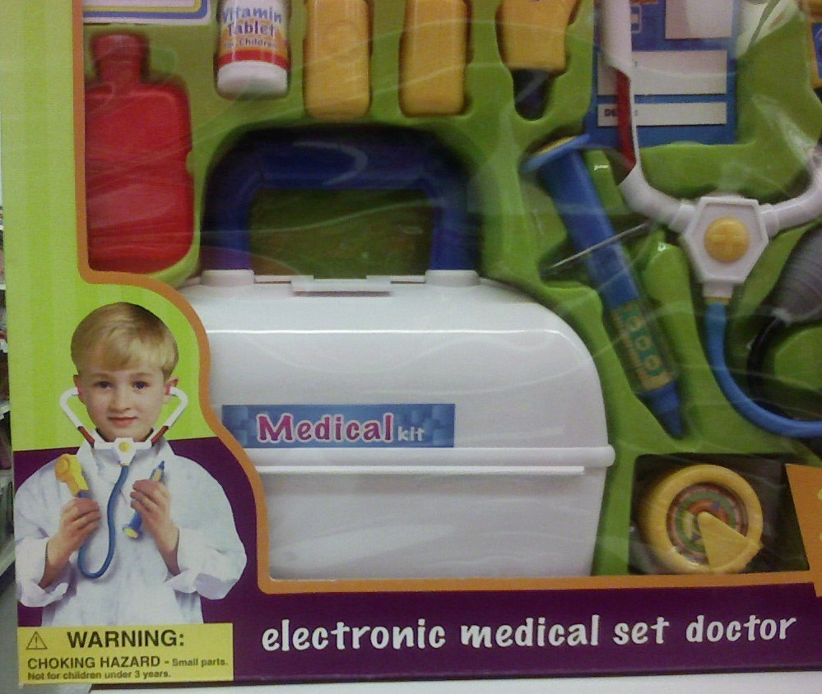
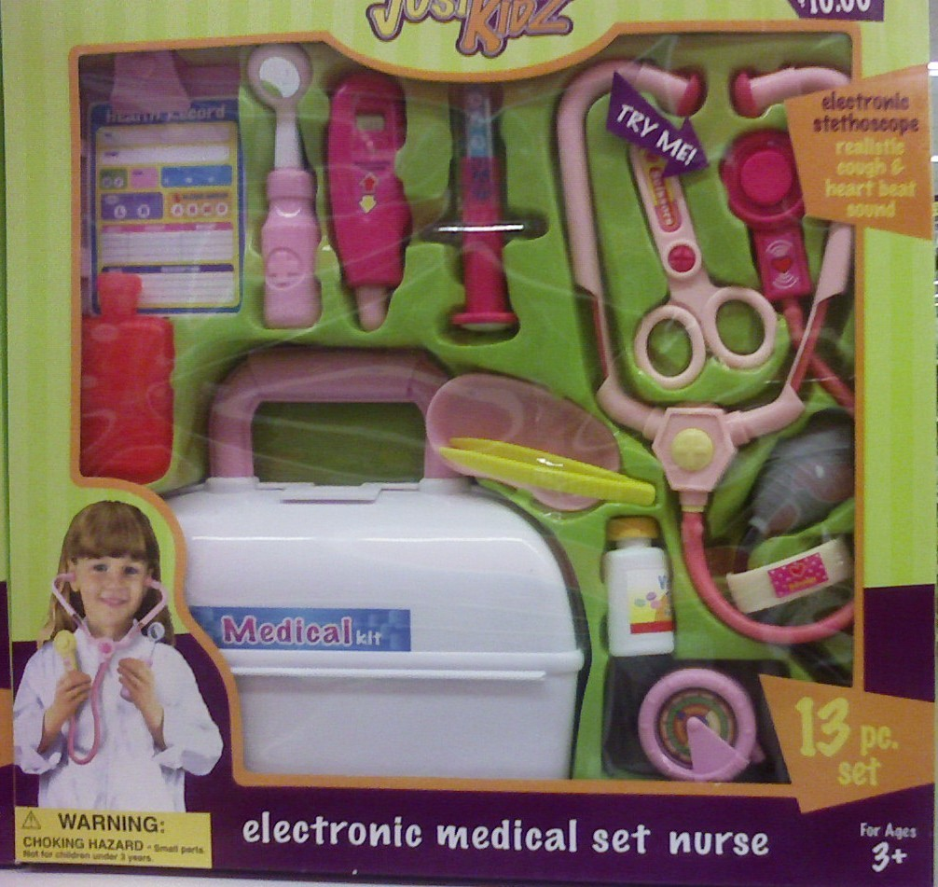
GENDER ROLE SOCIALIZATION
An infant is born with a sex and develops a gender.
Children are guided in this process by positive and negative sanctions.
Notes:
So an infant is born with a sex and develops a gender
--as Lorber says “sex categories become a gender status through naming, dress and the use of other gender markers”
Children are guided in this process by positive and negative sanctions.
--If a boy lifts a rock, we might say: “What a strong boy you are!”
---We give him a positive sanction because he is complying with masculine expectations.
But, if the same boy starts applying nail polish, we might react: “Boys don’t do that. Nail polish is for girls!”
--We give him negative sanction because he is violating gendered norms
---and we saw some of this in our Kane reading during the socialization lecture
And this goes on through childhood and adulthood.
--when kids are in school, peers police each other, and enforce gender norms on one another.
---(click twice) and the media, through toys and advertising, signal to children what careers are appropriate for them
Eventually, we all get a very clear picture of what is –at least normativly– expected from us.
--We learn how to be a man or a woman.

Slide 20
“DOING GENDER”
Gender is more than learning to act like a man or a woman
It is something we continually ‘do’ in our daily interactions
Gender is not a fixed identity; it is the product of social interactions
Gender is a matter of active doing, not a matter of natural being
Source: West and Zimmerman, 1987, “Doing Gender,” Gender and Society.
Notes:
But gender is not just about learning to act like a man or a woman, some sociologists argue.
(click) It is something that we continually do in our daily interactions with others.
Gender is not a fixed identity that we take with us into our interactions.
--(click) It is the product of those interactions.
(click) In other words, gender is a matter of active doing not a matter of natural being.
To be a man or a woman is to perform femininity and masculinity constantly.
--It is to choose behaviors, clothing, hairstyle, stance, body language
---even tone of voice considered suitable to a man or a woman.
Think about this for a second – can you identify a time where you were “doing gender”?

Slide 21
GENDER AS PERFORMANCE
Gender as performance undertaken by men and women (Goffman’s dramaturgical theory of social interaction)
Embedded in everyday interactions; carried out in the presence of others who are presumed to understand the cues
Gender performance casts socially guided interactions as ‘natural’
….and legitimates a fundamental division in society
Notes:
This idea of gender as a ‘performance’ is rooted in Erving Goffman’s dramaturgical theory of social interaction
Recall, symbolic interactionists study everyday human behavior in the context of face-to face interaction
--and argue that people create their social identities through interactions with one another
People—both men and women—are performing gender in the presence of others
--as your Lorber readings says “gender is constantly created and re-created out of human interaction”
This constant performance has implications (click)
--It casts socially guided interactions as natural
---and legitimates a fundamental division in society.
In other words, gender performance reinforces the idea that men and women are different.
--And as your Lorber and England readings outline
---it makes it easy for us to then believe that men and women should have different trajectories in work, family and life

Slide 22
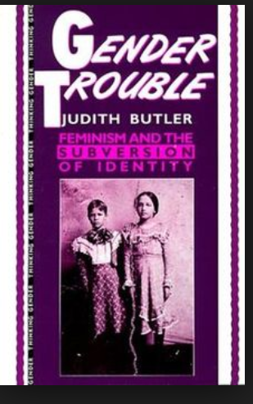
The “performativity” of gender – Judith Butler
https://www.youtube.com/watch?v=Bo7o2LYATDc

Slide 23
LORBER 1994
Gender as a Process…
Creates the social differences that define “woman” and “man”
Gender as Stratification…
Ranks men above women
Gender as Structure…
Divides work, legitimates those in power, and organizes sexuality and emotional life
Notes:
This last point about gender—that it reinforces and legitimates the idea that men and women are different--is what I want to focus on from your Lorber and England readings. Lorber first outlines how gender is a social construct--then (click) discusses the concept of gender as a process, a structure, a form of stratification. As a process, (click) gender creates the social differences that define “woman” and “man”---via interactions throughout our lives, we learn what is expected, see what is expected and act and react in expected ways ----in doing this we simultaneously construct and maintain the gender order (click) as a part of our stratification system, gender ranks men above women. --Lorber notes that women and men could be biologically different but socially equal---but this is not the practice of Western societies----this dichotomous ranking also places or signals value: men are dominant/normal/preferred…. women are not. Finally (click) looking at gender as structure, you can see that it divides work in the home and labor market--legitimates those in authority, and organizes sexuality and emotional life. Lorber says when gender is a major component of structured inequality--the devalued genders have less power, prestige and economic rewards than the valued genders.
This leads us nicely into our England reading

Slide 24
ENGLAND 2010
Why has there been progress in gender equality in some areas of life, but not others?
The continued devaluation of female activities and female-types jobs
Asymmetric incentives to cross gender barriers
The personal realm
Professional vs blue-collar gender integration
Notes:
This is a nice overview piece
--Yes we’ve seen some progress in gender equality, but England argues it has been uneven and stalled in some arenas
Why is this? What does she say/examples does she give?
--Good, click (read bullets)
Your England article explains each of these very nicely
--for the sake of time, I want to spend our remaining time discussing the implications of gender as a social construct

Slide 25
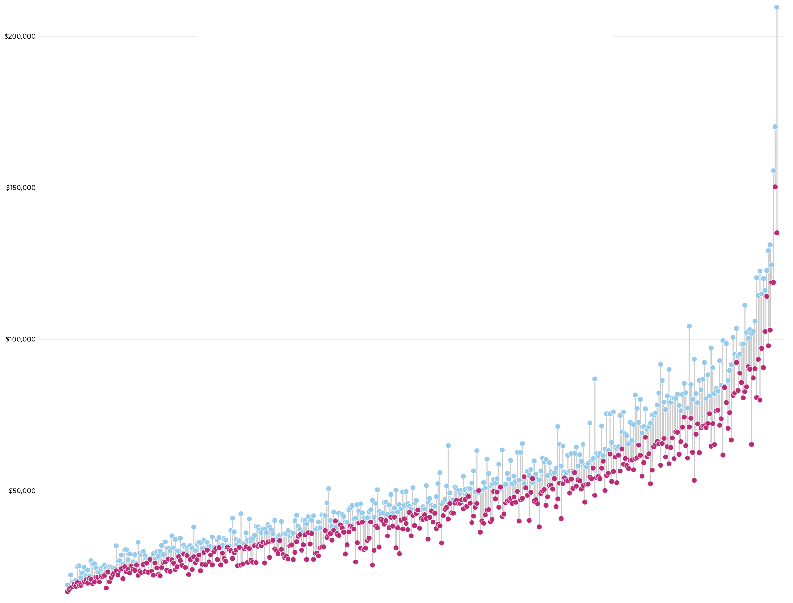
THE GENDER PAY GAP
Women earn
less than men
in 439 or 446
major U.S. occupations
Men
Women
Source: http://graphics.wsj.com/gender-pay-gap/
Notes:
Recall similar to race, gender is a social construct and a social reality with real implications
One of those real implications is that women continue to make significantly less money than men.
According to this data from The Wall Street Journal
--(click) women earn less than men in 439 of 446 major U.S. occupations.
The X axis of this graph describes different occupation.
--The Y axis of this graph is the median salary of men and women.

Slide 26
THE GENDER PAY GAP
Men
Physicians & Surgeons
Median Male Wage: $209,596
Median Female Wage: $135,169
Women
Source: http://graphics.wsj.com/gender-pay-gap/
Notes:
In almost every occupation, women earn less than men
For example, the median wage for male physicians and surgeons is $209,596,
--and the median wage for female physicians is $135,169. Over $80K lower!

Slide 27
THE GENDER PAY GAP
Men
Lawyers
Median Male Wage: $131,238
Median Female Wage: $103,119
Women
Source: http://graphics.wsj.com/gender-pay-gap/
Notes:
Similar patterns exist among lawyers.
Male lawyers have a median salary of $131,238 and
female lawyers have a median salary of $103,119.

Slide 28
THE GENDER PAY GAP
Men
Chief Executive Officers
Median Male Wage: $129,285
Median Female Wage: $97,947
Women
Source: http://graphics.wsj.com/gender-pay-gap/
Notes:
What about executives?
Once again, median yearly earnings are $129,285 for males and $97,947 for women.

Slide 29
THE GENDER PAY GAP
Men
Maids and Housekeepers
Median Male Wage: $24,843
Median Female Wage: $20,016
Women
Source: http://graphics.wsj.com/gender-pay-gap/
Notes:
And for occupations at the very bottom of the income distribution.
--Even in heavily female-typed jobs such as housekeeping, men make more than women.
Why is this? What factors contribute to the persistence of a gender wage gap?
--A recent study, by two top economists from our ILR school—Francine Blau and Lawrence Kahn
---using a very high quality dataset try to explain the gender wage gap

